Slide 1

constrained Maxima and Minima

Slide 2

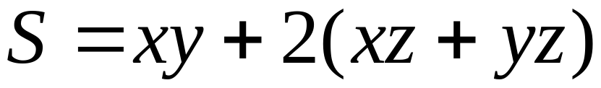

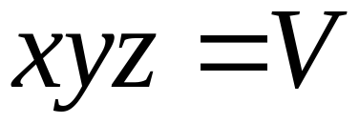


Example ：
Find minimum of
Subject to

Slide 3
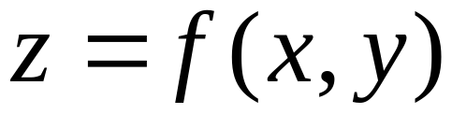
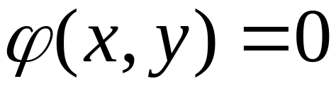
In general
Min/maximize objective function
Subject to
constraint

Slide 4
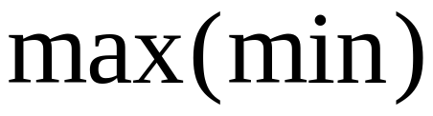
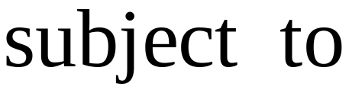
The objective function
The constrained

Slide 5

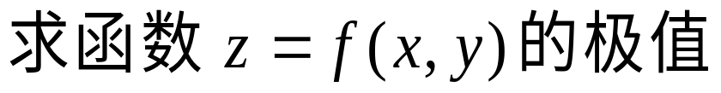
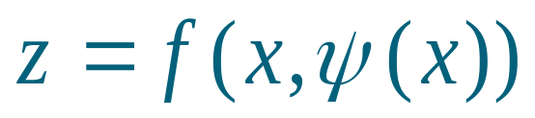
条件极值
无条件极值:
对自变量只有定义域限制
极值问题
条 件 极值 :
对自变量除定义域限制外,
还有其他条件限制
条件极值的求法:
例如 ,
方法1 代入法.
转化
求一元函数
的无条件极值题

Slide 6
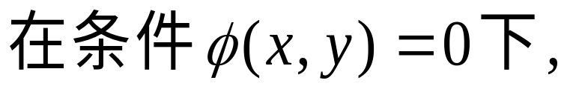
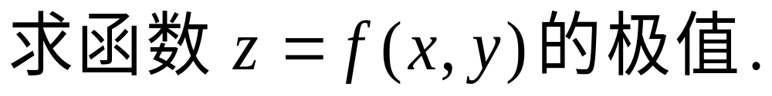
方法2 拉格朗日乘数法.
例如,
简单问题用代入法
一般问题用拉格朗日乘数法

Slide 7

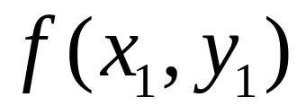
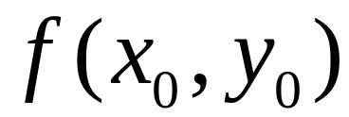
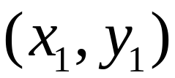
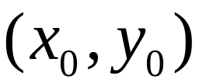
Geometric interpretation
Notice that in general
maximum constrained maximum
constrained maximum
Absolute maximum
constraint

Slide 8
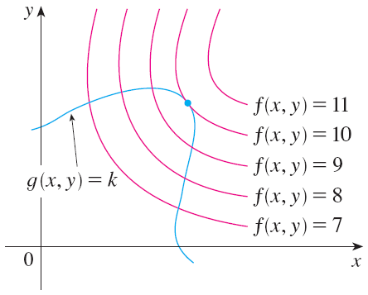
How to find constrained extrema ?

Slide 9
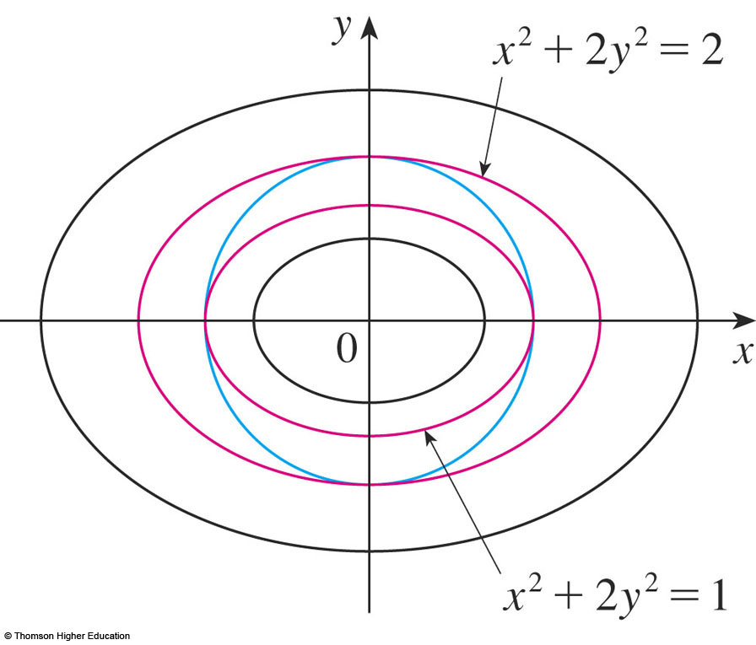
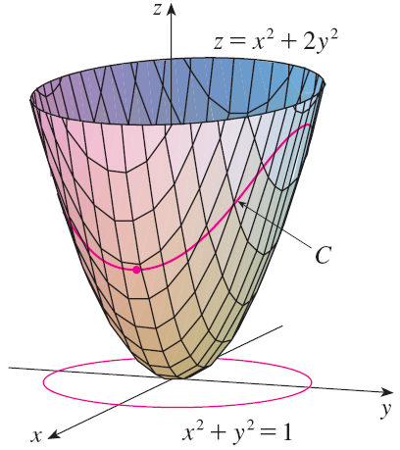
How to find constrained extrema ?

Slide 10
A necessary condition
Level curves of
And the curve
touch/tangent to each other at the point!

Slide 11
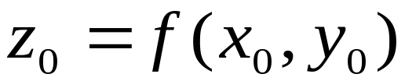
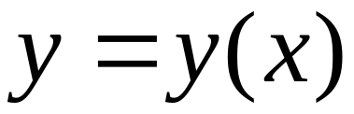
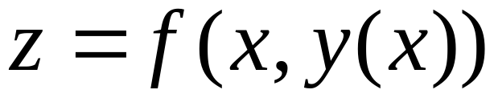
if is a constrained extremum of subject to
Implicitly defined by the equation
Then
Obtains a local extremum at x = x₀

Slide 12
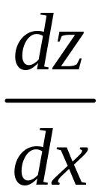
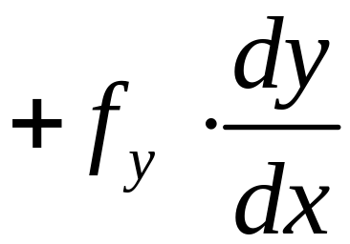
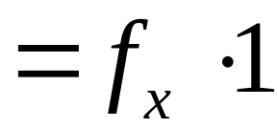
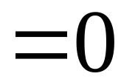
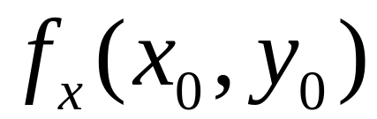
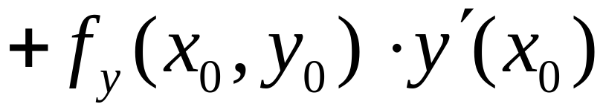
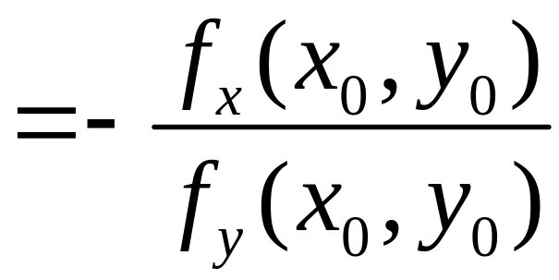
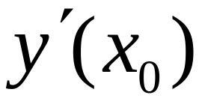

Slide 13
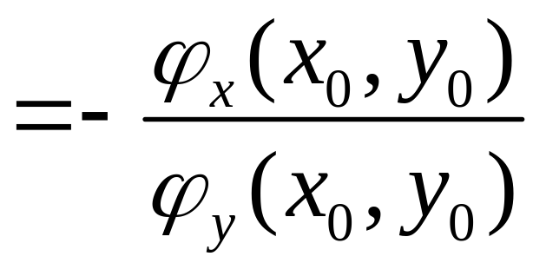
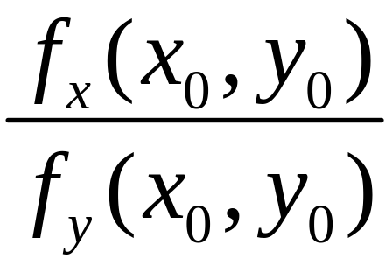
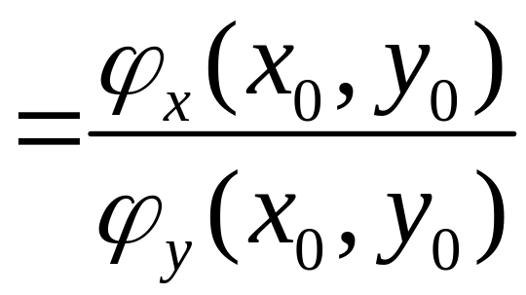

on the other hand
By the Chain rule

Slide 14
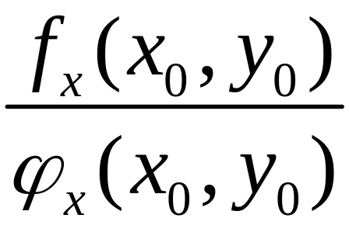
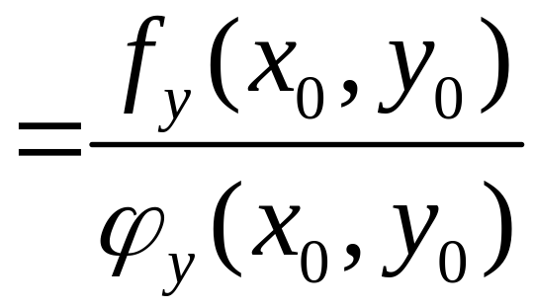
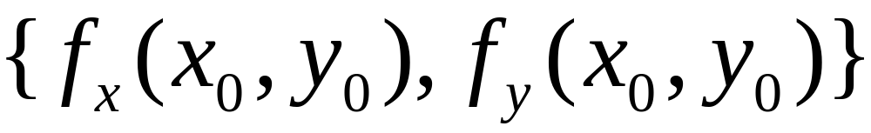
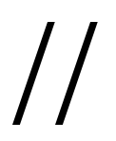
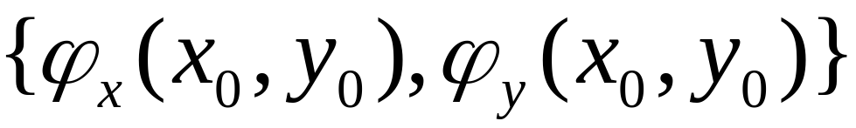
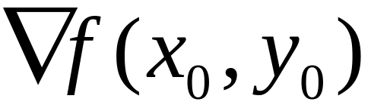
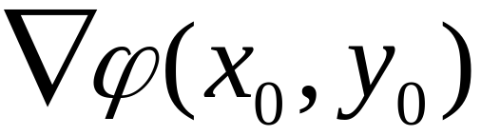
or
i.e.
or

Slide 15
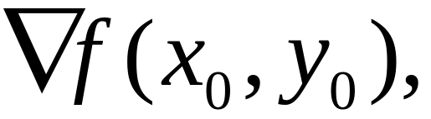
Theorem
The function
obtains a local extreme at (x₀, y₀) subject to the constraint:
Then
i.e.
Linear dependent
or

Slide 16
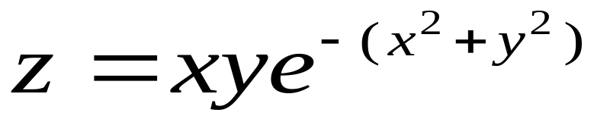
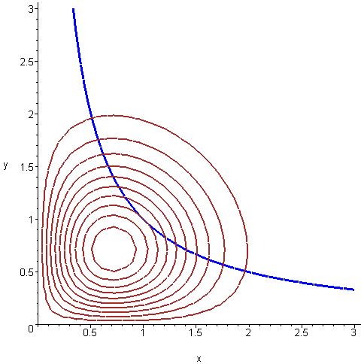
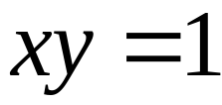
level curves
Not local extrema
Local extrema
constraint
dzx:=contourplot(x*y*exp(-x^2-y^2),x=0..3,y=0..3,contours=10,thickness=2,color=brown): ystj:=implicitplot(x*y=1,x=0..3,y=0..3,color=blue,thickness=3):
display(dzx,ystj);

Slide 17

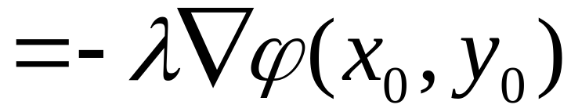
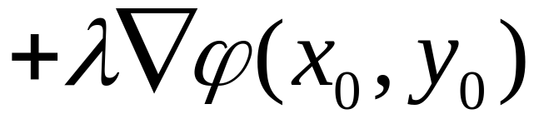
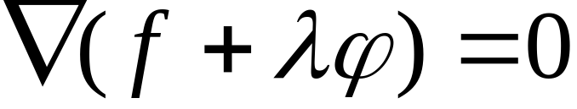
means：
such that
or
or

Slide 18
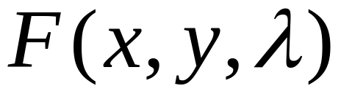
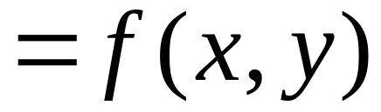
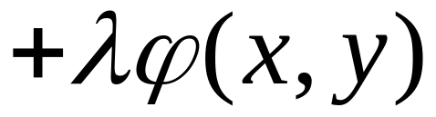
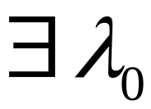
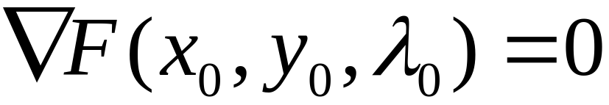
Let
Theorem
function
has a constrained extremum at (x₀, y₀) subject to
Then, there is a number ：
Such that

Slide 19
Lagrange Function
Lagrange multiplier
The critical point of the Lagrange function is a candidate for a constrained extremum

Slide 20















Example
Objective function：
Subject to:
Solution
Let
So

Slide 21



so
is a candidate for a constrained extremum
At this point:

Slide 22


with(plots):
qumian:=implicitplot3d({z=x*y},x=0..1.5,y=0..1.5,z=0..1/3.5,style=patchcontour):
pingmian:=implicitplot3d({x+y=1},x=0..1,y=0..1,z=0..1/3.5,color=blue):
x_axis:=plot3d([u,0,0],u=0..1.8,v=0..0.01,thickness=2):
y_axis:=plot3d([0,u,0],u=0..1.8,v=0..0.01,thickness=2):
z_axis:=plot3d([0,0,u],u=0..0.5,v=0..0.01,thickness=2):
display(qumian,pingmian,x_axis,y_axis, z_axis,orientation=[-20,70]);

Slide 23



Slide 24




Slide 25






6.6多元函数的极值
Example
与
implicitplot3d({z=x*y,x+y=1},x=0..1,y=0..1,z=0..1/3.5,color=red);

Slide 26

z= xy level curves
constrained maximum
tangent
dzx:=contourplot(x*y,x=0..1,y=0..1,contours=35,thickness=2,color=brown): ystj:=implicitplot(x+y=1,x=0..3,y=0..3,color=blue,thickness=3):
display(dzx,ystj);

Slide 27













Objective function：
Subject to：
Solution
Let
Find critical points
Four stationary points

Slide 28








Four candidates：
constrained maximum
constrained minimum

Slide 29









constrained maximum
constrained minimum
with(plots):
qumian:=plot3d([sqrt(z)*cos(t),sqrt(z/2)*sin(t),z],z=0..1+sin(t)*sin(t),t=0..2*Pi,color=yellow):
zhumian:=plot3d([cos(t),sin(t),z],z=0..1+sin(t)*sin(t),t=0..2*Pi,color=green):
quxian2:=spacecurve([cos(t),sin(t),0],t=0..2*Pi,color=red,thickness=6):
quxian:=spacecurve([cos(t),sin(t),1+sin(t)*sin(t)],t=0..2*Pi,color=red,thickness=6): x_axis:=plot3d([u,0,0],u=-1..2,v=0..0.01,thickness=3):
y_axis:=plot3d([0,u,0],u=-1..1.5,v=0..0.01,thickness=3):
z_axis:=plot3d([0,0,u],u=-1..3.3,v=0..0.01,thickness=3):
display(qumian,quxian2,quxian,x_axis,y_axis,z_axis,scaling=constrained,orientation=[40,70]);

Slide 30
Lagrange Function
Lagrange multiplier
The critical point of the Lagrange function is a candidate for a constrained extremum

Slide 31





Lagrange Function
For functions of three variables
The critical point of the Lagrange function is a candidate for a constrained extremum

Slide 32



If there are two constraints
Lagrange Function
The critical point of the Lagrange function is a candidate for a constrained extremum

Slide 33





Exercise
用Lagrange乘数法再解例6.7
求函数
在约束条件
下的极小值
解
作Lagrange函数

Slide 34










求 F 的驻点
由实际问题知，在该驻点，S 取得最小值

Slide 35
END

